Slide 1

Unit 04.01.03
CS 5220:
COMPUTER COMMUNICATIONS
Subnetting
XIAOBO ZHOU, Ph.D.
Professor, Department of Computer Science

Slide 2
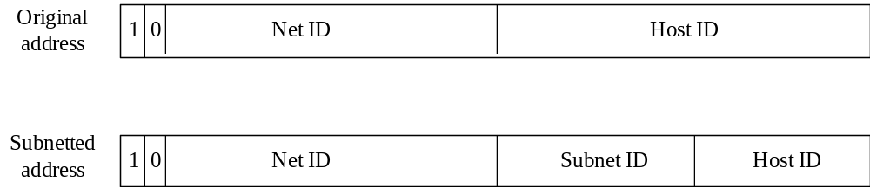
Subnet Addressing
Subnet addressing introduces another hierarchical level
Transparent to remote networks
Simplifies management of multiplicity of LANs
Masking used to find subnet number

Slide 3
Subnetting Scheme
Organization has Class B address (16 host ID bits) with network ID: 150.100.0.0
Create subnets with up to 100 hosts each
  7 bits sufficient for each subnet (IP mask 7 bits)
  16-7 = 9 bits for subnet ID (2^9 – 2 = 510 subnets)
Apply subnet mask to IP addresses to find corresponding subnet
  Example: Find subnet for 150.100.12.176
  IP address = 10010110 01100100 00001100 10110000
  Mask = 11111111 11111111 11111111 10000000 (7 0s)
  AND = 10010110 01100100 00001100 10000000
  Subnet = 150.100.12.128
  Subnet address used by routers within organization

Slide 4
Subnet Range
  Given the subnet 150.100.12.128
  IP address 150.100.12.128 is used to identify the subnetwork
  IP address 150.100.12.255 is used to broadcast packets in the subnet
  Range of the subnet IP address is between
  IP address = 10010110 01100100 00001100 10000001
  to
  IP address = 10010110 01100100 00001100 11111110
  That is, 150.100.12.129 to 150.100.12.254

Slide 5
Subnet Example
H1
H2
150.100.12.154
150.100.12.176
150.100.12.128
150.100.12.129
150.100.0.1
R1
To the rest of
H3
H4
the Internet
150.100.12.4
150.100.12.24
150.100.12.55
150.100.12.0
150.100.12.1
R2
H5
150.100.15.54
150.100.15.11
150.100.15.0

Slide 6
Routing with Subnetworks
IP layer in hosts and routers maintain a routing table
Originating host: To send an IP packet, consult routing table
  If destination host is in same network, send packet directly using appropriate network interface
  Otherwise, send packet indirectly; typically, routing table indicates a default router
Router: Examine IP destination address in arriving packet
  If destination IP address not own, router consults routing table to determine next-hop and associated network interface & forwards packet

